Slide 1
CAPITULO 5A
VOCABULARY

Slide 2
Objective
I can listen to information about family and parties.

Slide 3
The following slides show vocabulary from chapter 5A. Each slide has audio so that you practice your vocabulary pronunciation correctly.

Slide 4
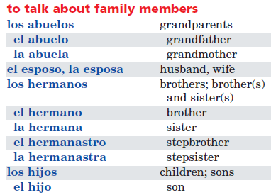

Slide 5
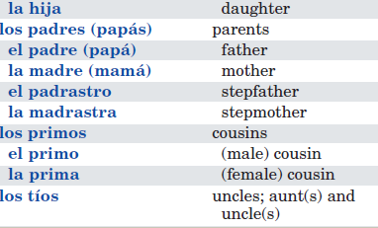

Slide 6
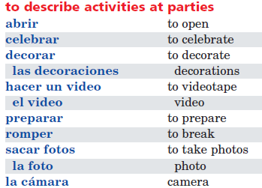

Slide 8
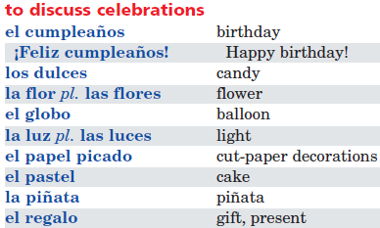

Slide 9
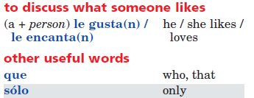

Slide 10
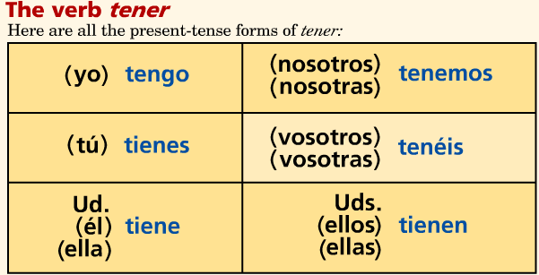
To indicate possession or relationship

Slide 11
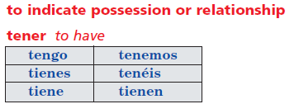

Slide 13
http://www.phschool.com/atschool/realidades/animated_verbs/Realidades-Grammar-LV1.htm

Slide 14
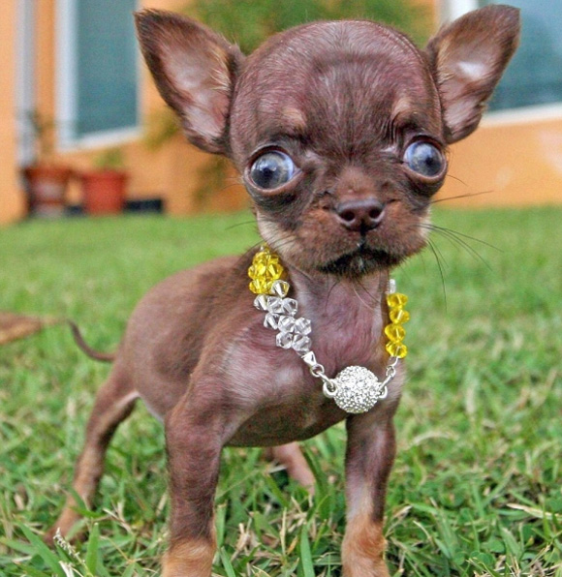
el perro
Yo soy el jefe.
.

Slide 15
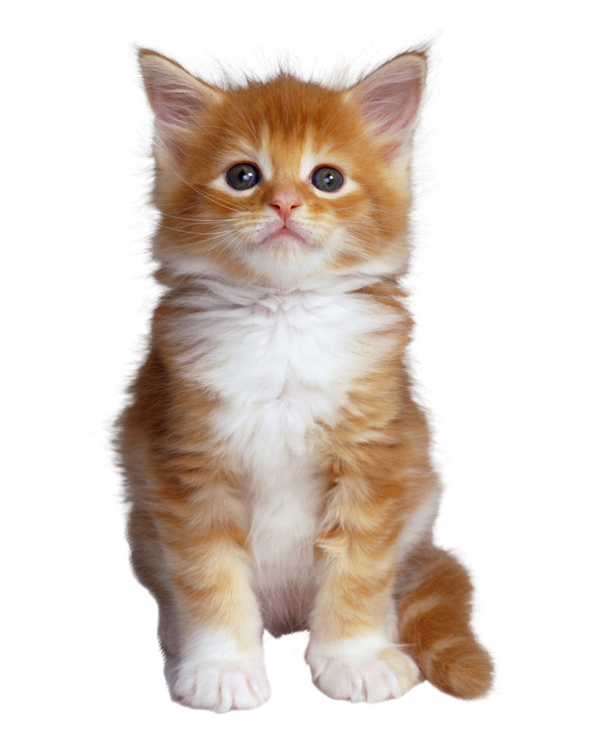
el gato

Slide 16
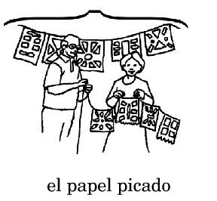

Slide 17
las flores

Slide 19
el pastel

Slide 20
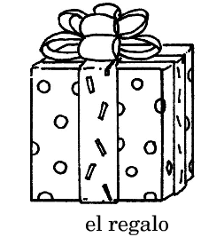

Slide 21
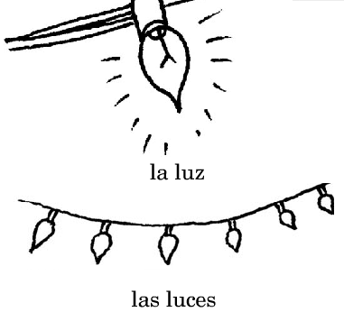

Slide 22
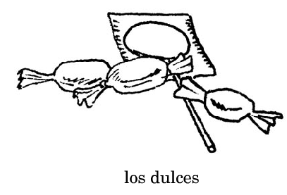

Slide 23
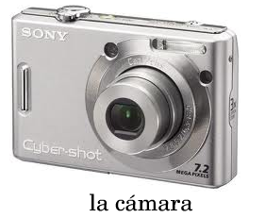

Slide 24
los globos

Slide 25
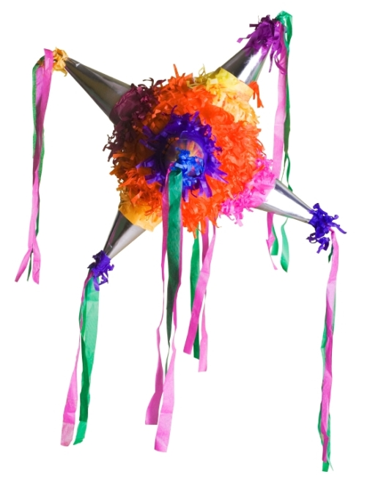
la piñata

Slide 26
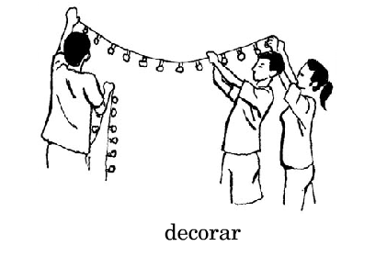

Slide 28
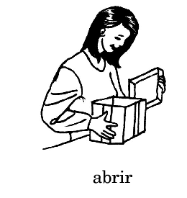

Slide 29
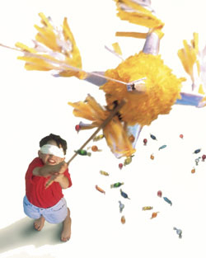
romper

Slide 30
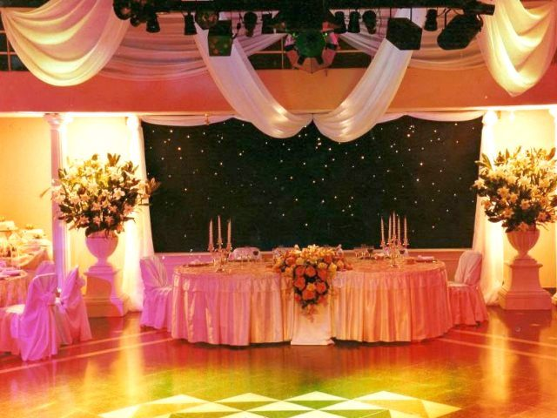
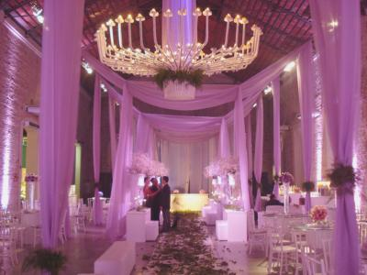
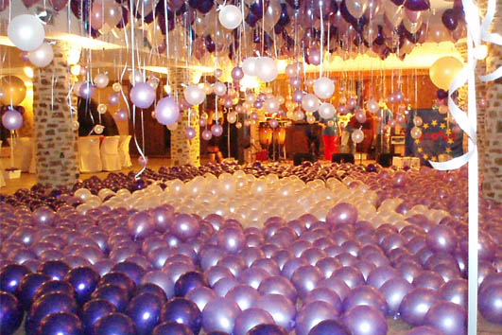
las decoraciones
las decoraciones

Slide 31
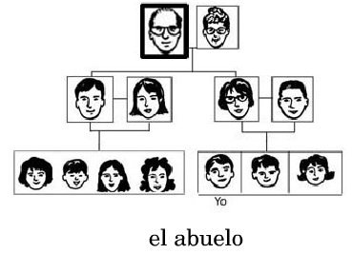

Slide 32
